Slide 1



WELCOME TO OUR CLASS
Class: 5
Teacher: Hoàng Thị Hồng
Ai Mo A primary school

Slide 2
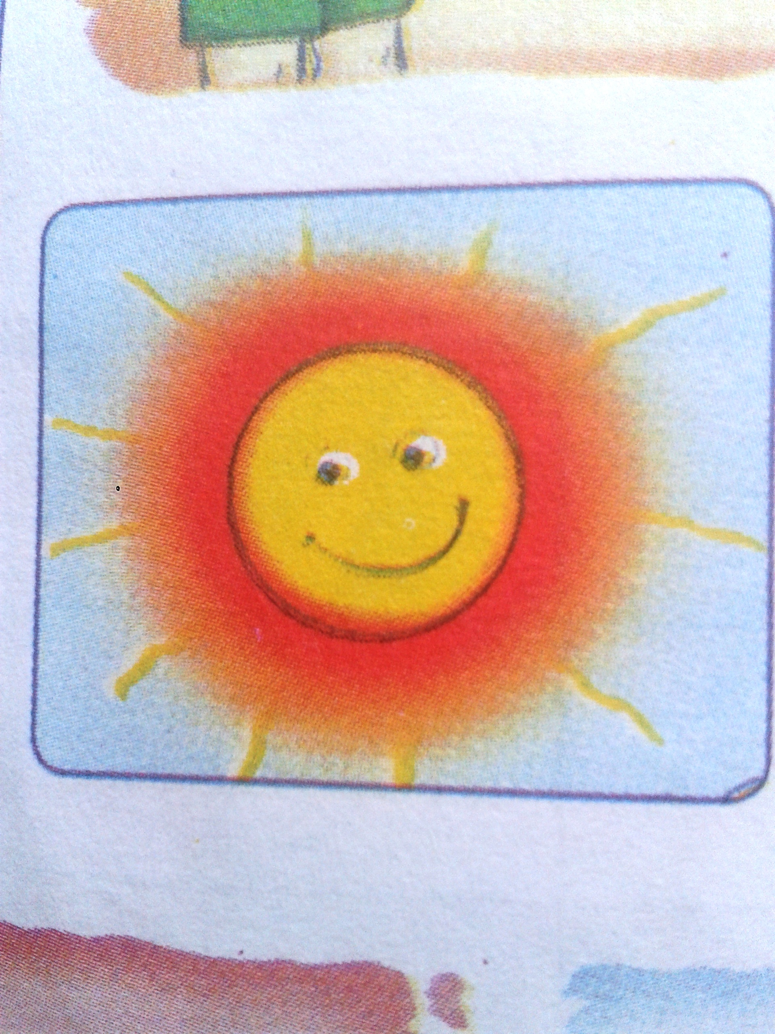
What will the weather be like tomorrrow ?
It will be _______________
sunny

Slide 3
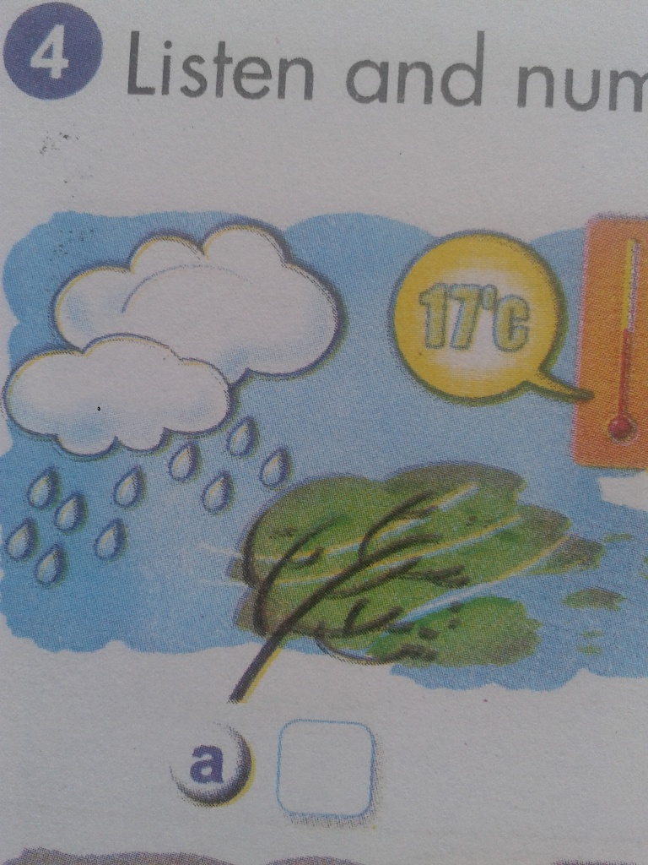
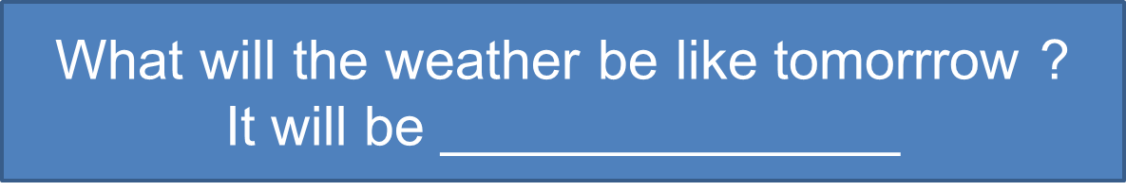
rainy and windy

Slide 4
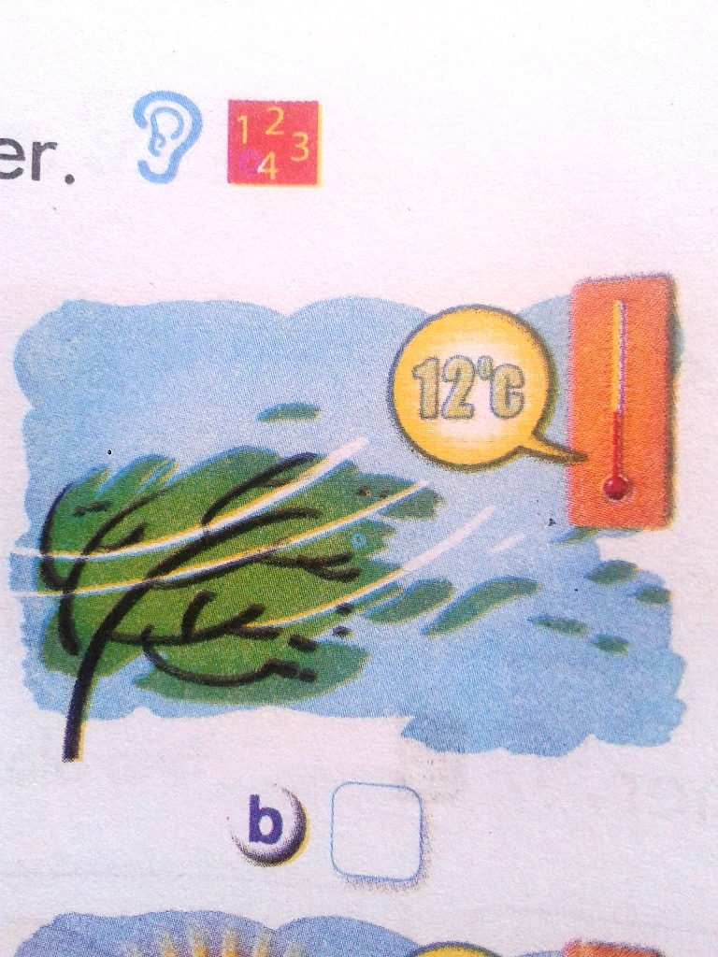
cold and windy

Slide 5
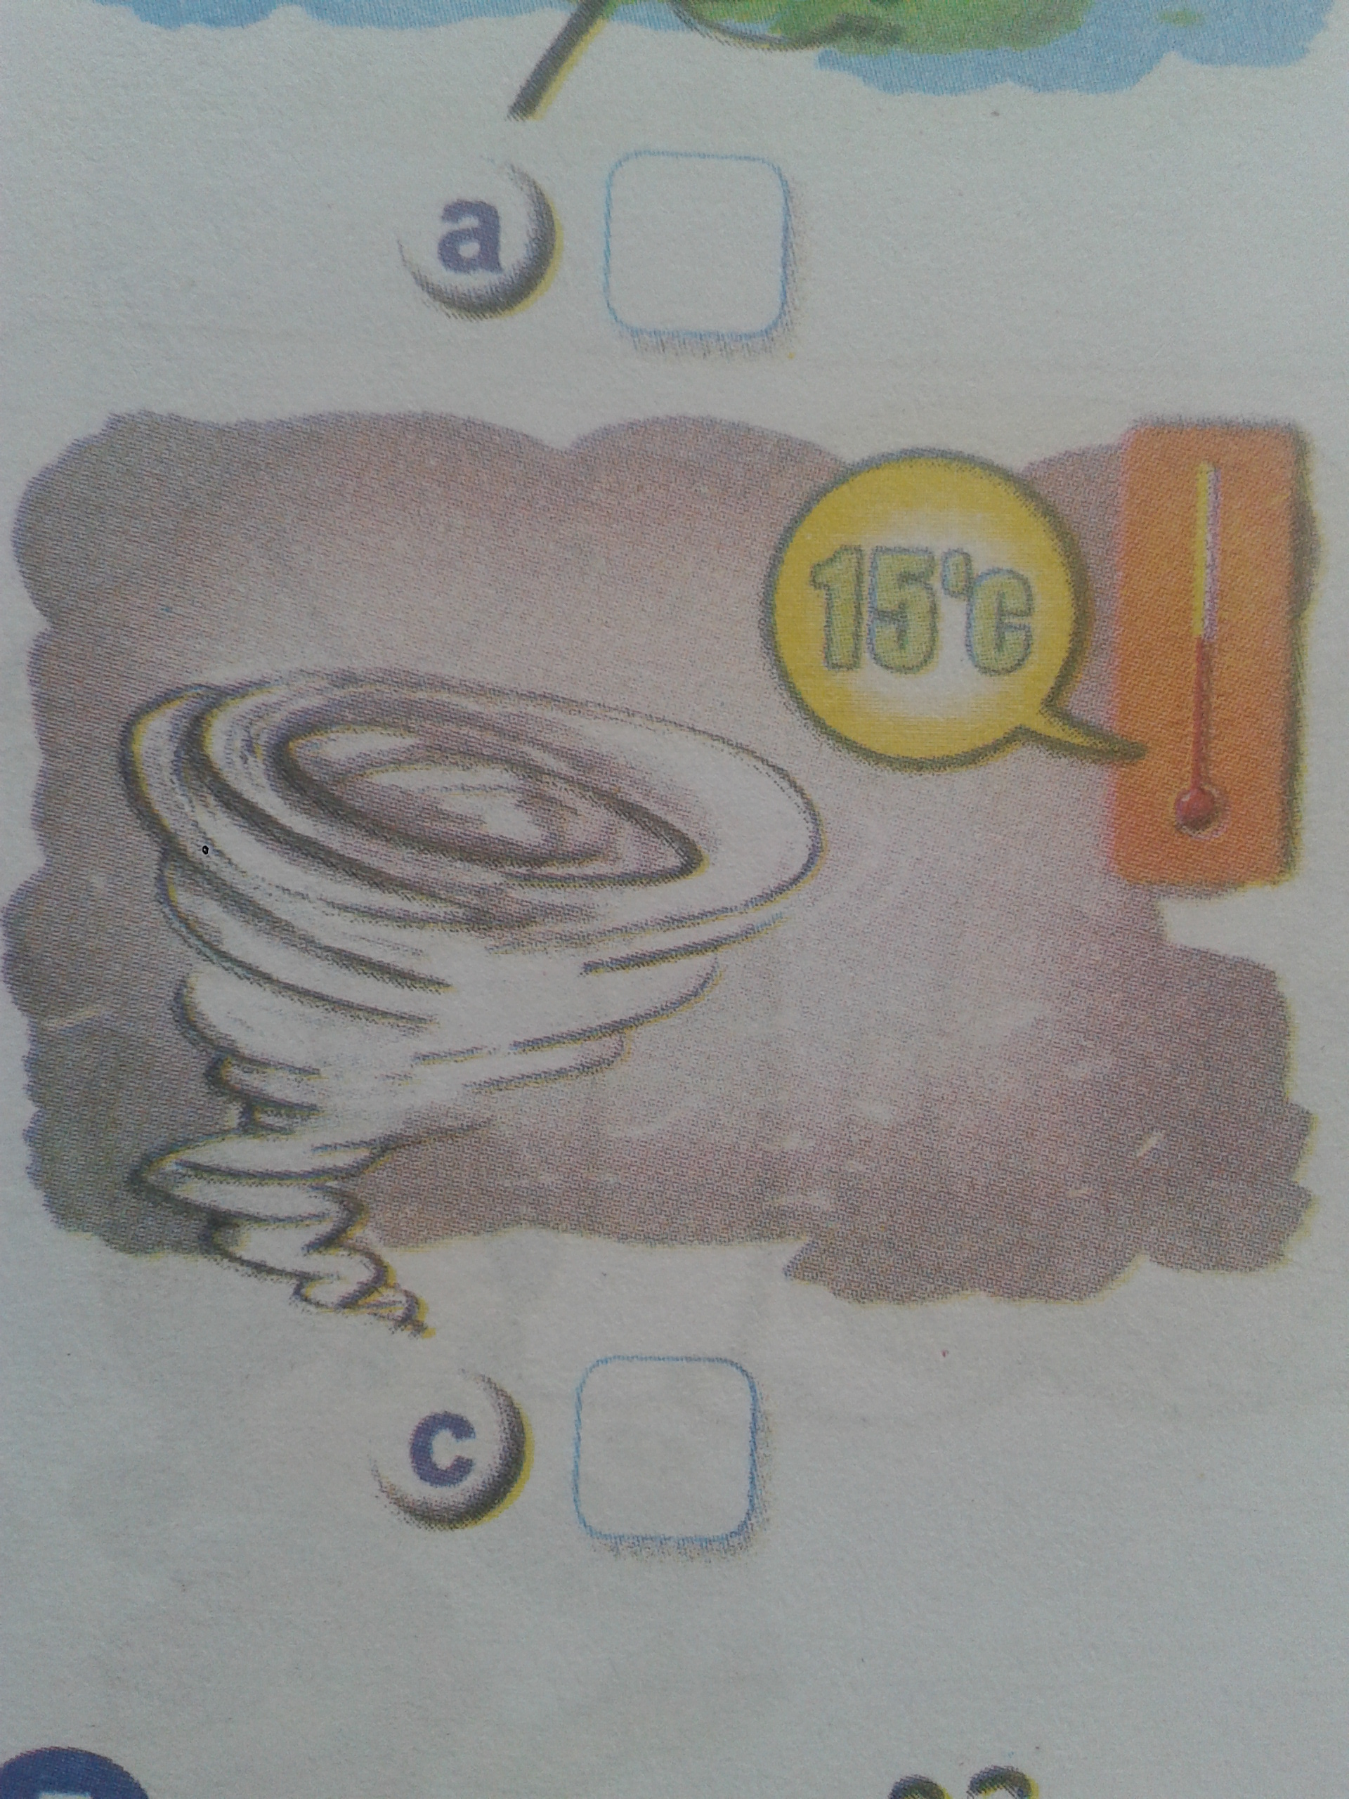
stormy

Slide 6

1. Listen and repeat
Storm/‘stɔ:mi/
Cold /‘kould/

Slide 7

told
old
worn
storm
1. Listen and repeat
popcorn
story
fold
sold
Storm/‘stɔ:mi/
Storm/‘stɔ:mi/
Cold /‘kould/
popcorn
told
worn
old
storm
fold
story
sold

Slide 8
1. Listen and repeat
Stormy/sto:mi/
Cold/kould/
Storm/‘stɔ:mi/ | Cold /‘kould/
Popcorn Worn Storm Story | Told Old Fold Sold
2. Listen and read together

Slide 9
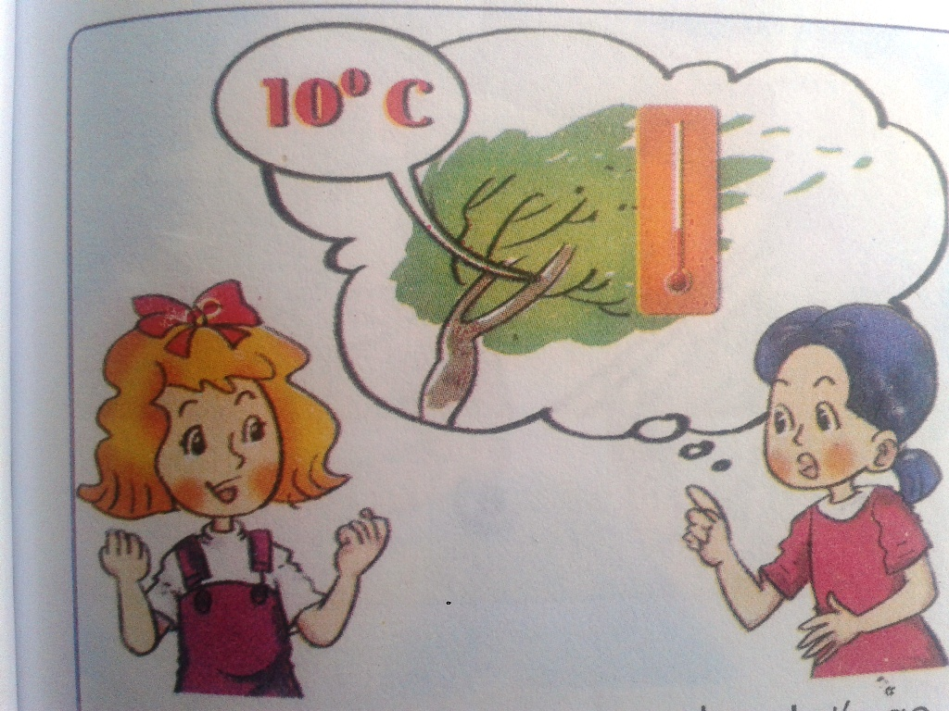
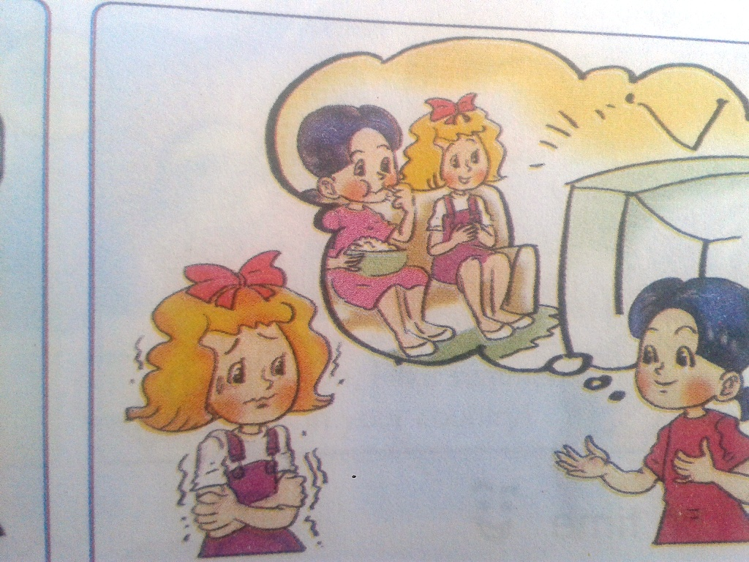
Linda: Tomorrow is Sunday. Let’s go for a picnic.
Mai: It will be cold and stormy.
Linda: How do you know it?
Mai: I watched the weather forecast on TV.
Linda: I don’t like storms at all.
Mai: So tomorrow we won’t go for a picnic. We’ll stay at home, eat popcorn and watch films on TV.
a
b

Slide 10
1. Listen and repeat
Stormy/sto:mi/
Cold/kould/
2. Listen and
read together
3. Listen and
number

Slide 11
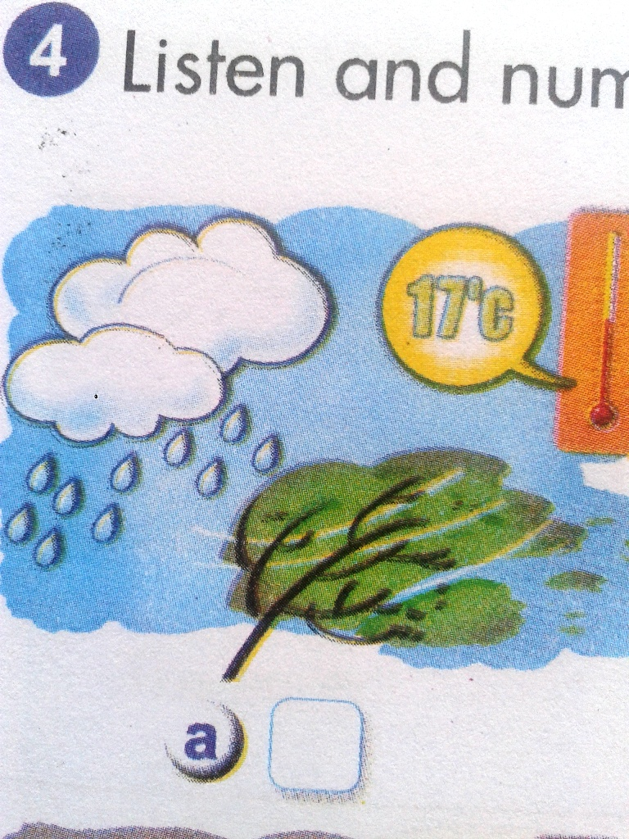

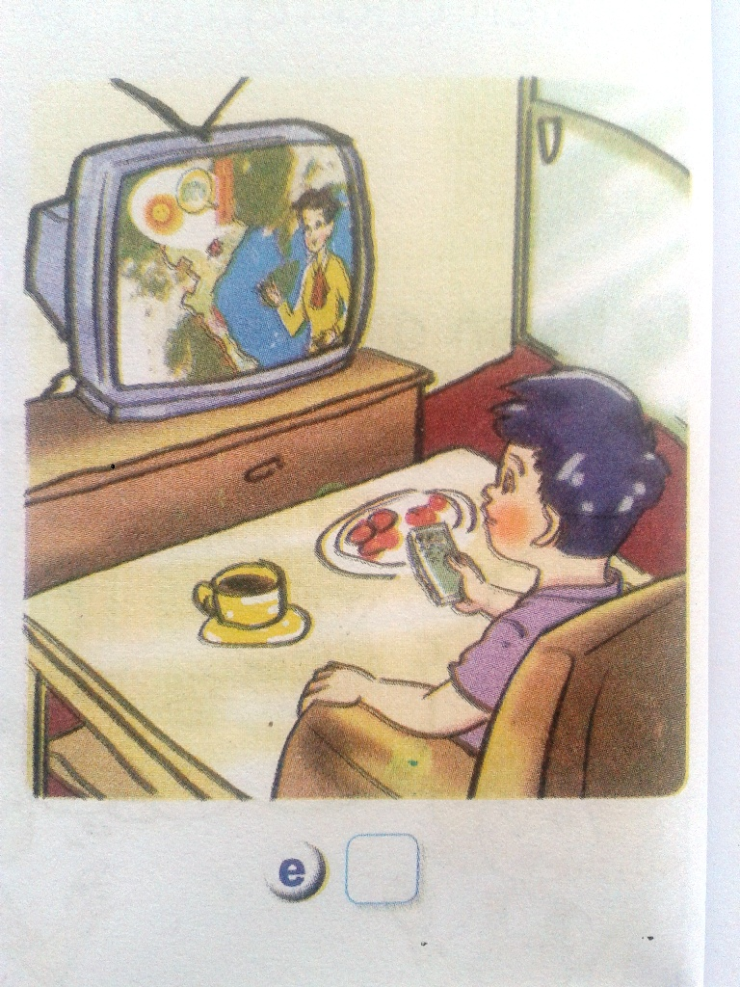
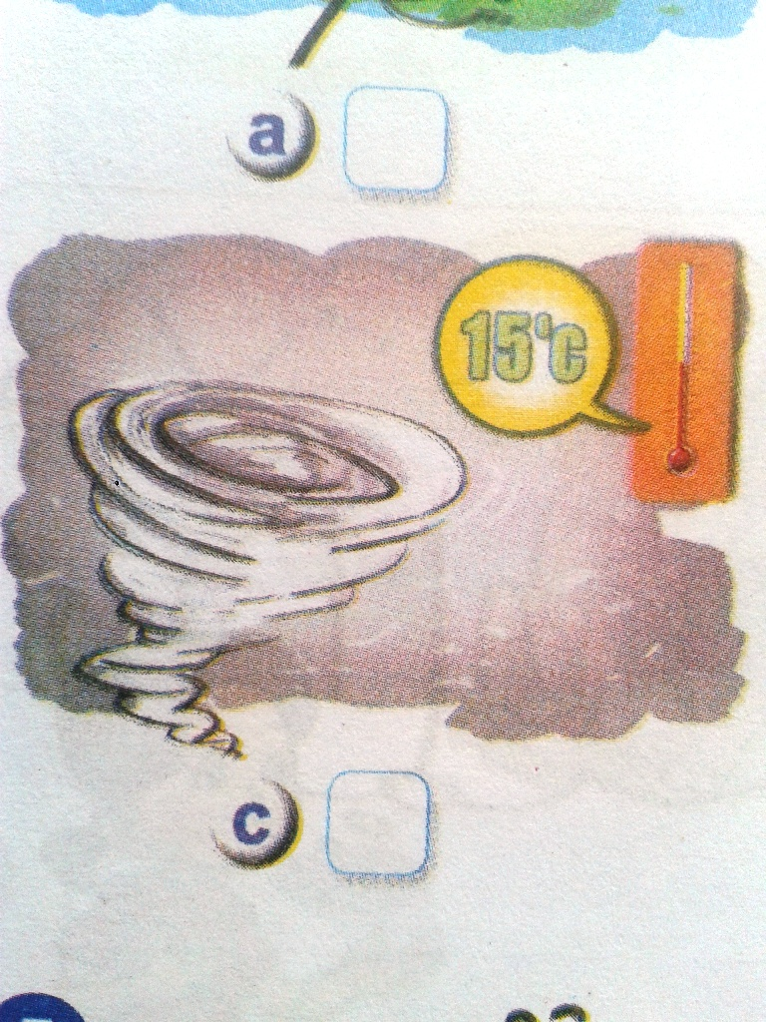
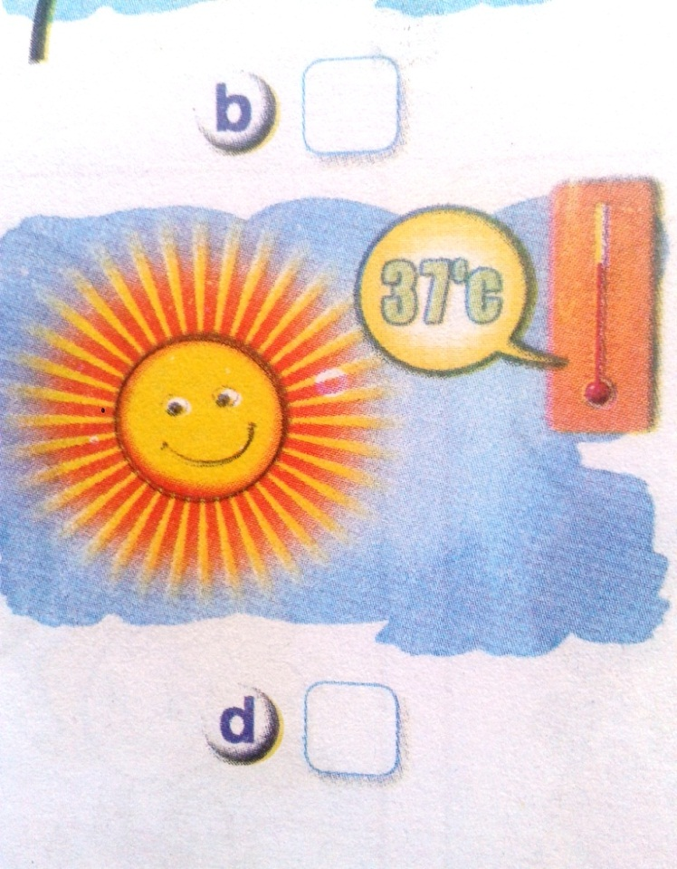
4.Listen and number
2
5
1
3
4

Slide 12
1. Listen and repeat
Stormy/sto:mi/ Cold/kould/
2. Listen and read together
3. Listen and number
Keys: a.2 b.5 c.1 d.3 e.4
4. Homework
- Practise the dialogue at home.
Write 4 sentences about the weather tomorrow.
Prepare Unit 16. Lesson 3

Slide 13


good bye!

